Slide 1



SPRINTS
BIG DATA MASTERCLASS #9
COVID-19 ANALYSIS
BY MOHAMED ABDELSATAR

Slide 2

CONTENT
01
INTRO
02
BUSINESS REQUIREMENT
03
VISUALIZATION
04
TECHNICAL REQUIREMENTS
05
INGESTION & STORAGE
06
PROCESSING
07
OOZIE WORKFLOW

Slide 3



INTRO
This is a final project presented to Sprints. in this project we have implemented the main phases we learned through the course

Slide 4





BUSINESS REQUIREMENT
Objective n° 1
Objective n° 2
Objective n° 3
show on a map the top 10 ranking countries in death rate
show on a map the top 10 ranking countries in testing rate
show the top 10 ranking countries in testing rate on a pie chart

Slide 5
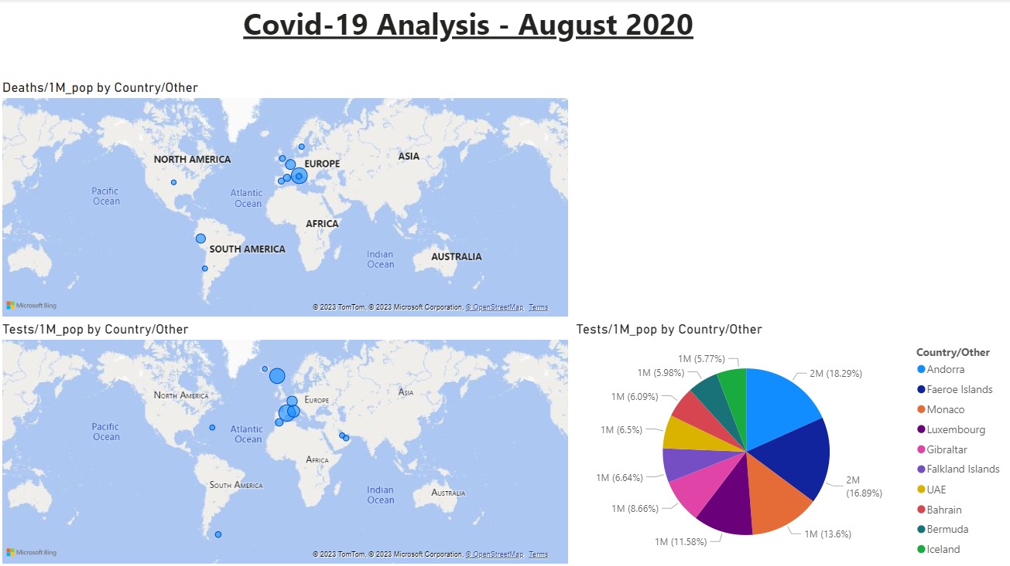

Slide 6
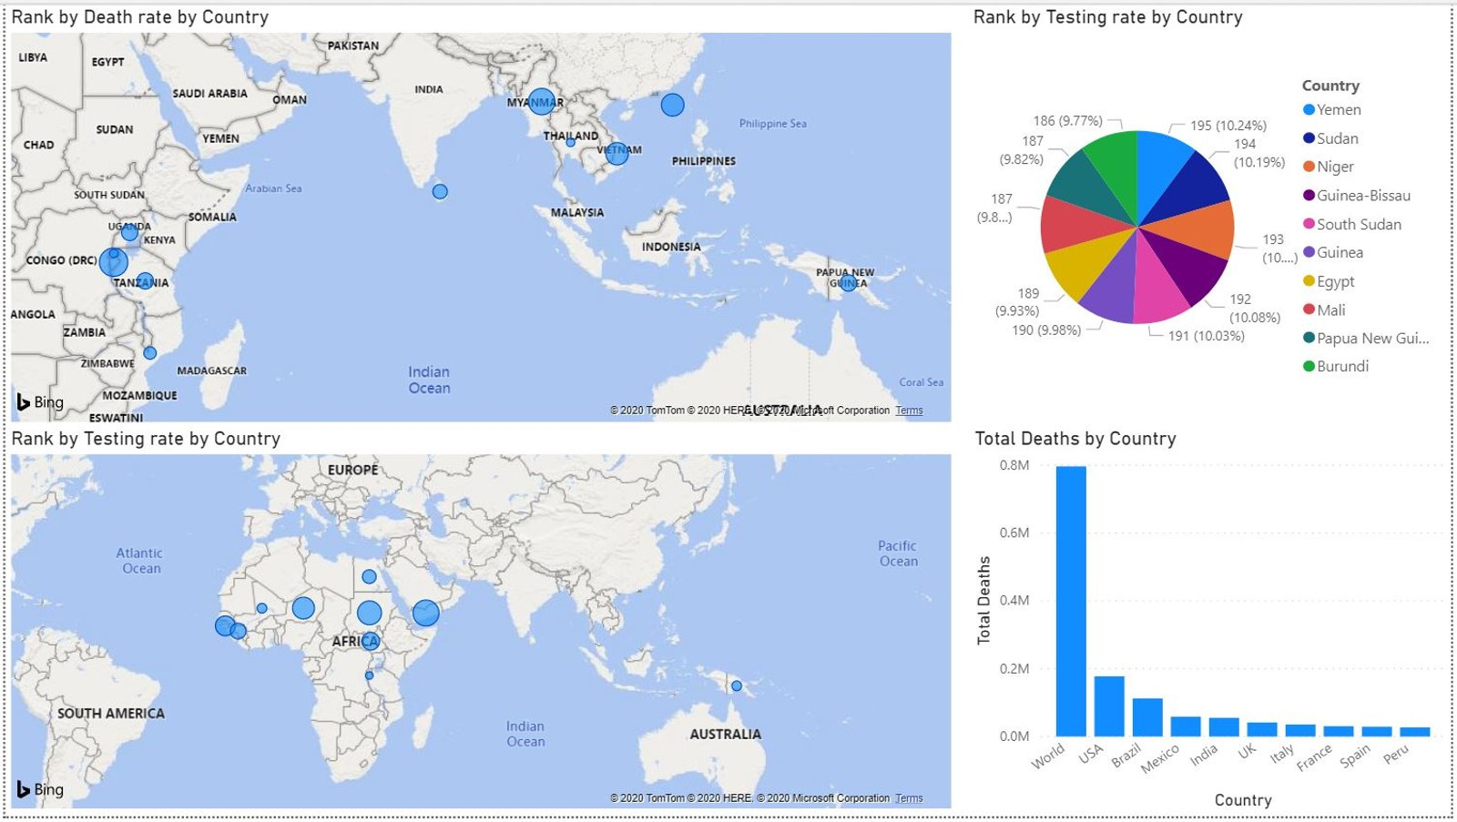

Slide 7

TECHNICAL REQUIREMENTS

Slide 8

01
02
03
04
INGESTION
STORAGE
PROCESSING
OOZIE WORKFLOW

Slide 9
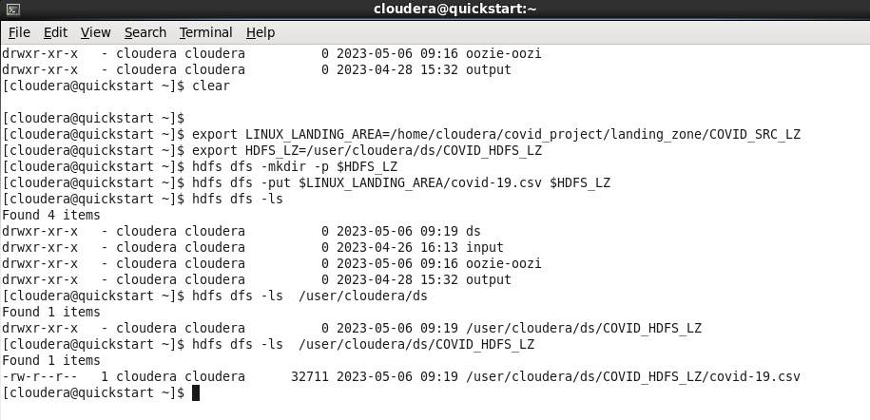
INGESTION & STORAGE

Slide 10
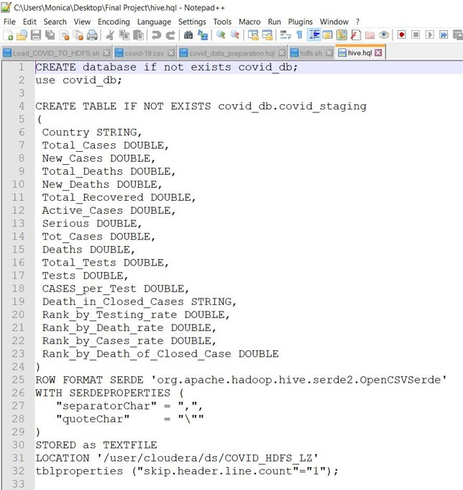
PROCESSING 1-3

Slide 11
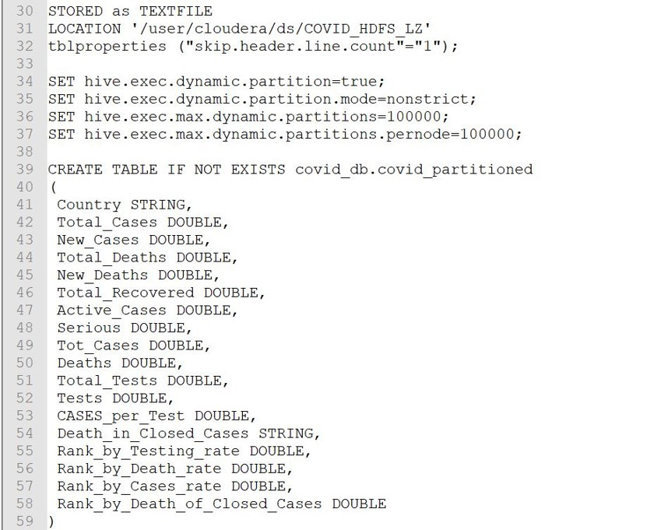
PROCESSING 2-3

Slide 12
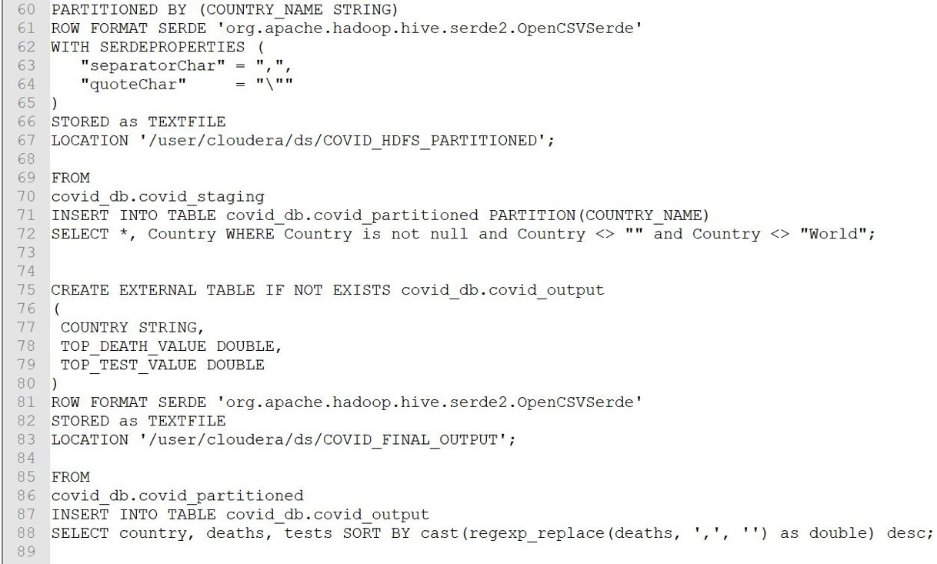
PROCESSING 3-3

Slide 13
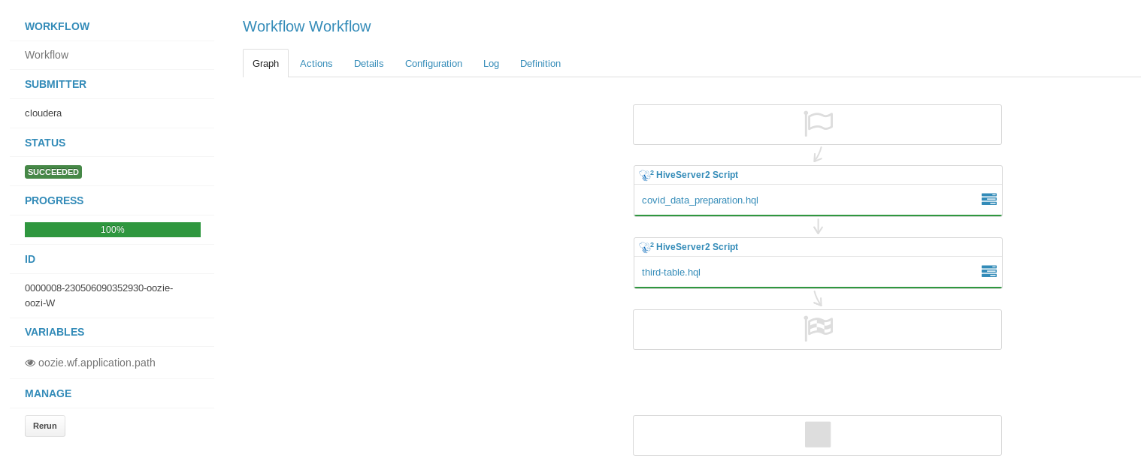
OOZIE WORKFLOW

Slide 14

THANK YOU SO MUCH SPRINTS FOR BEING A GREAT COMPANY TO TRAIN WITH AND THANKS TO MY MENTOR THROUGHOUT THIS COURSE, YOUR GUIDANCE AND SUPPORT HAVE BEEN INVALUABLE
SPRINTS

